Slide 1
Unemployed Elves
Mariia L, Greg Terrell, Dipesh Jha, Sameer Baig

Slide 2
Elevator Pitch
Problem
Contracted companies hired by Amazon have no streamlined form of driver documentation at end of shift
Solution
Internal system that logs driver checklist
Closed Database
Records all checklists
Contains all current drivers

Slide 3
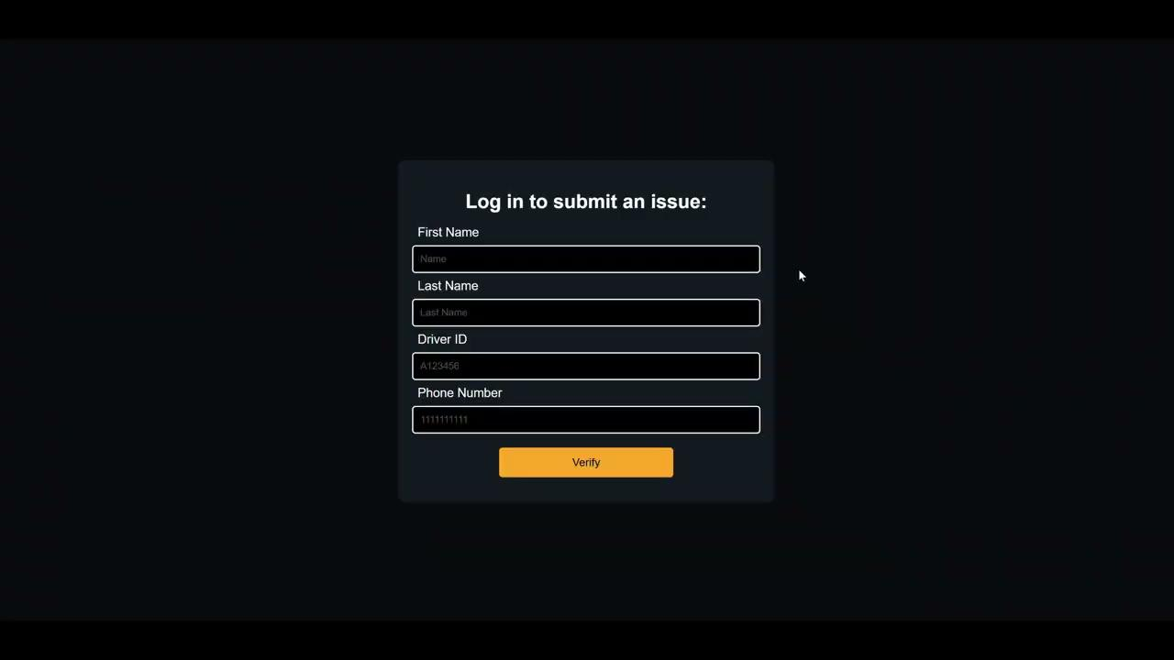
Overview

Slide 4
First Page
User Story
As an Amazon delivery driver, I want the form to display error messages for invalid inputs, so I can ensure all required information is entered correctly.
As an Amazon delivery driver, I want to provide my Driver ID along with my personal details, so the system can uniquely identify me.
Requirement
Input validation for all required fields.
Integration with backend API /login.
Clear UI and error messages for invalid inputs.

Slide 5
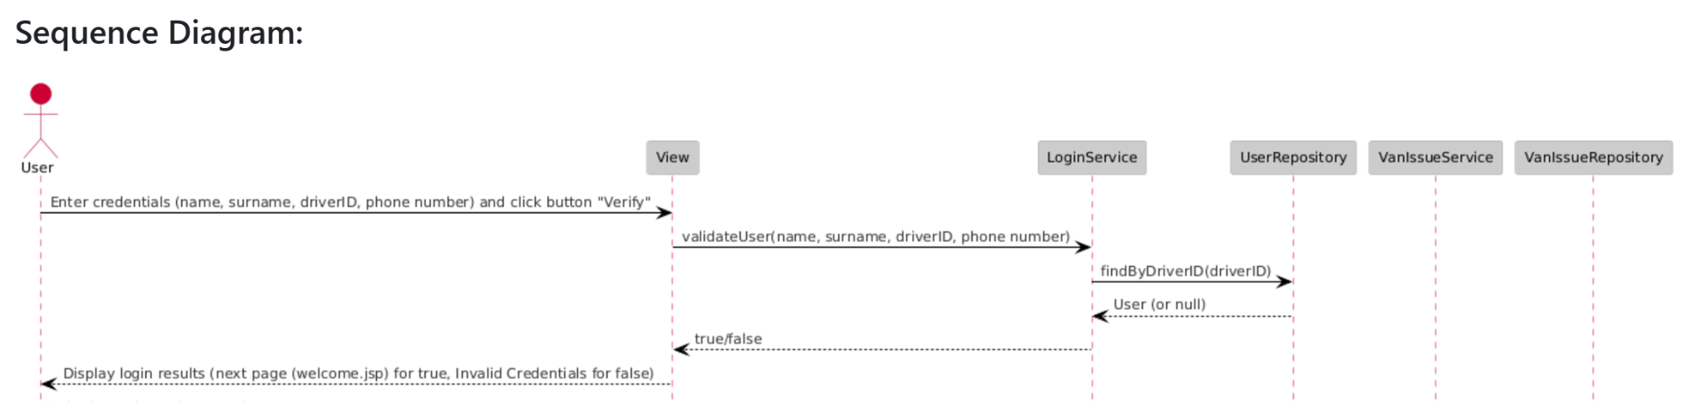
First Page - Design

Slide 6
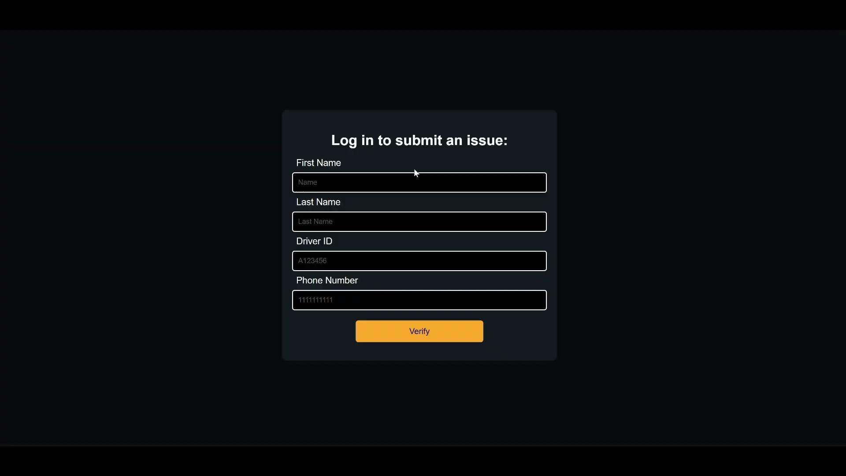
First Page Implementation

Slide 7
Second Page
User Story
As an Amazon delivery driver, I want to document issues with vans without using hand-written notes.
Requirement
The second page shall consist of a data collection form prompting the user to input the following: date and time, VIN, license plate, license state, issue region checklist, and issue description

Slide 8
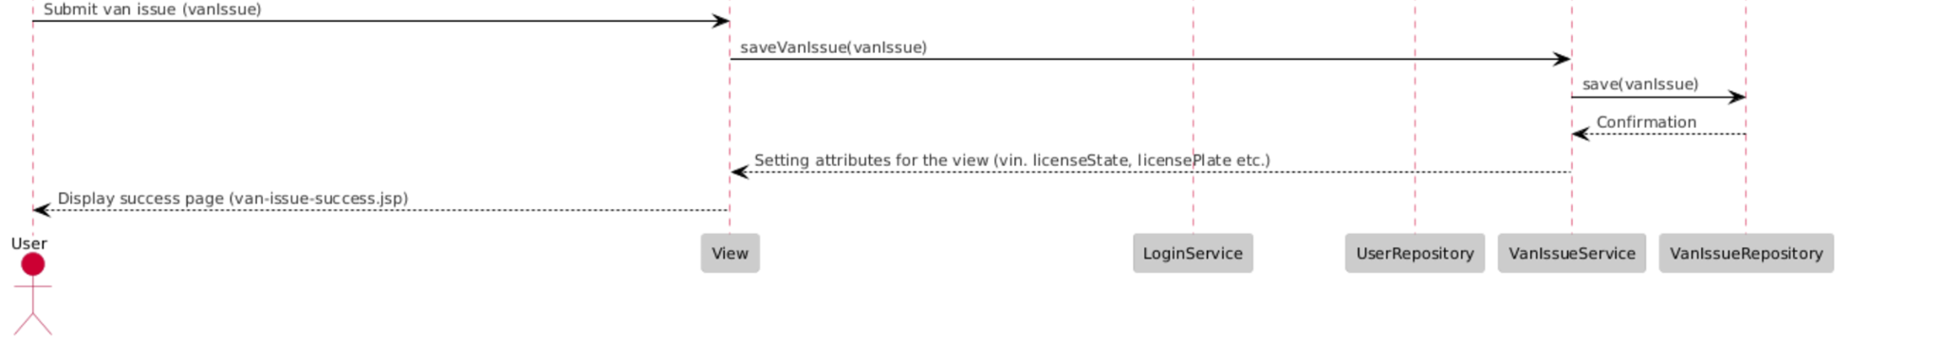
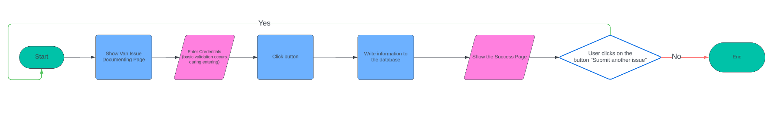
Second Page Design

Slide 9
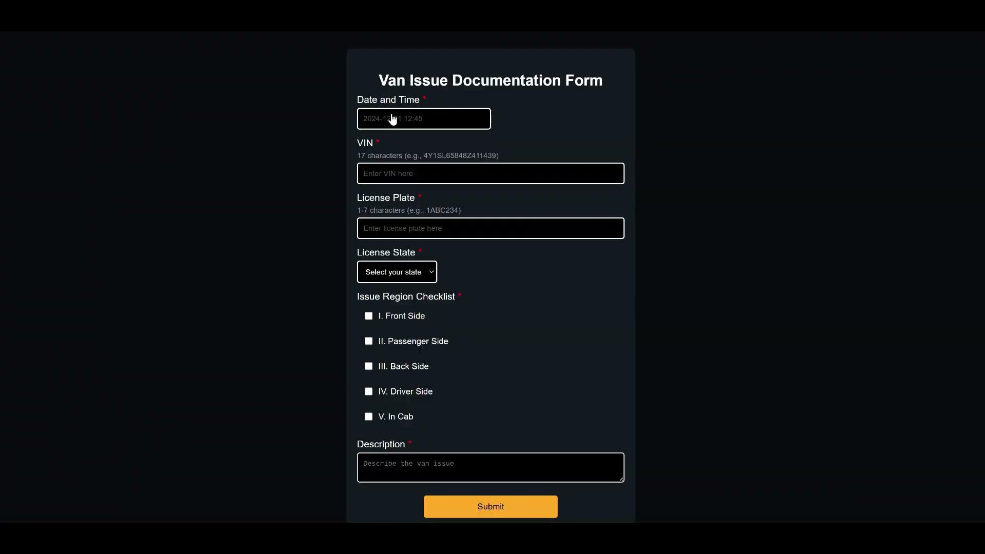
Second Page Implementation

Slide 10
Database Setup
User Story
As an Amazon delivery driver, I don’t want to repeatedly type in my credentials.
Requirement
Records in the database shall contain driver_id from the first page to uniquely identify user.
The provided information shall be verified against the pre-loaded database of user details.

Slide 11
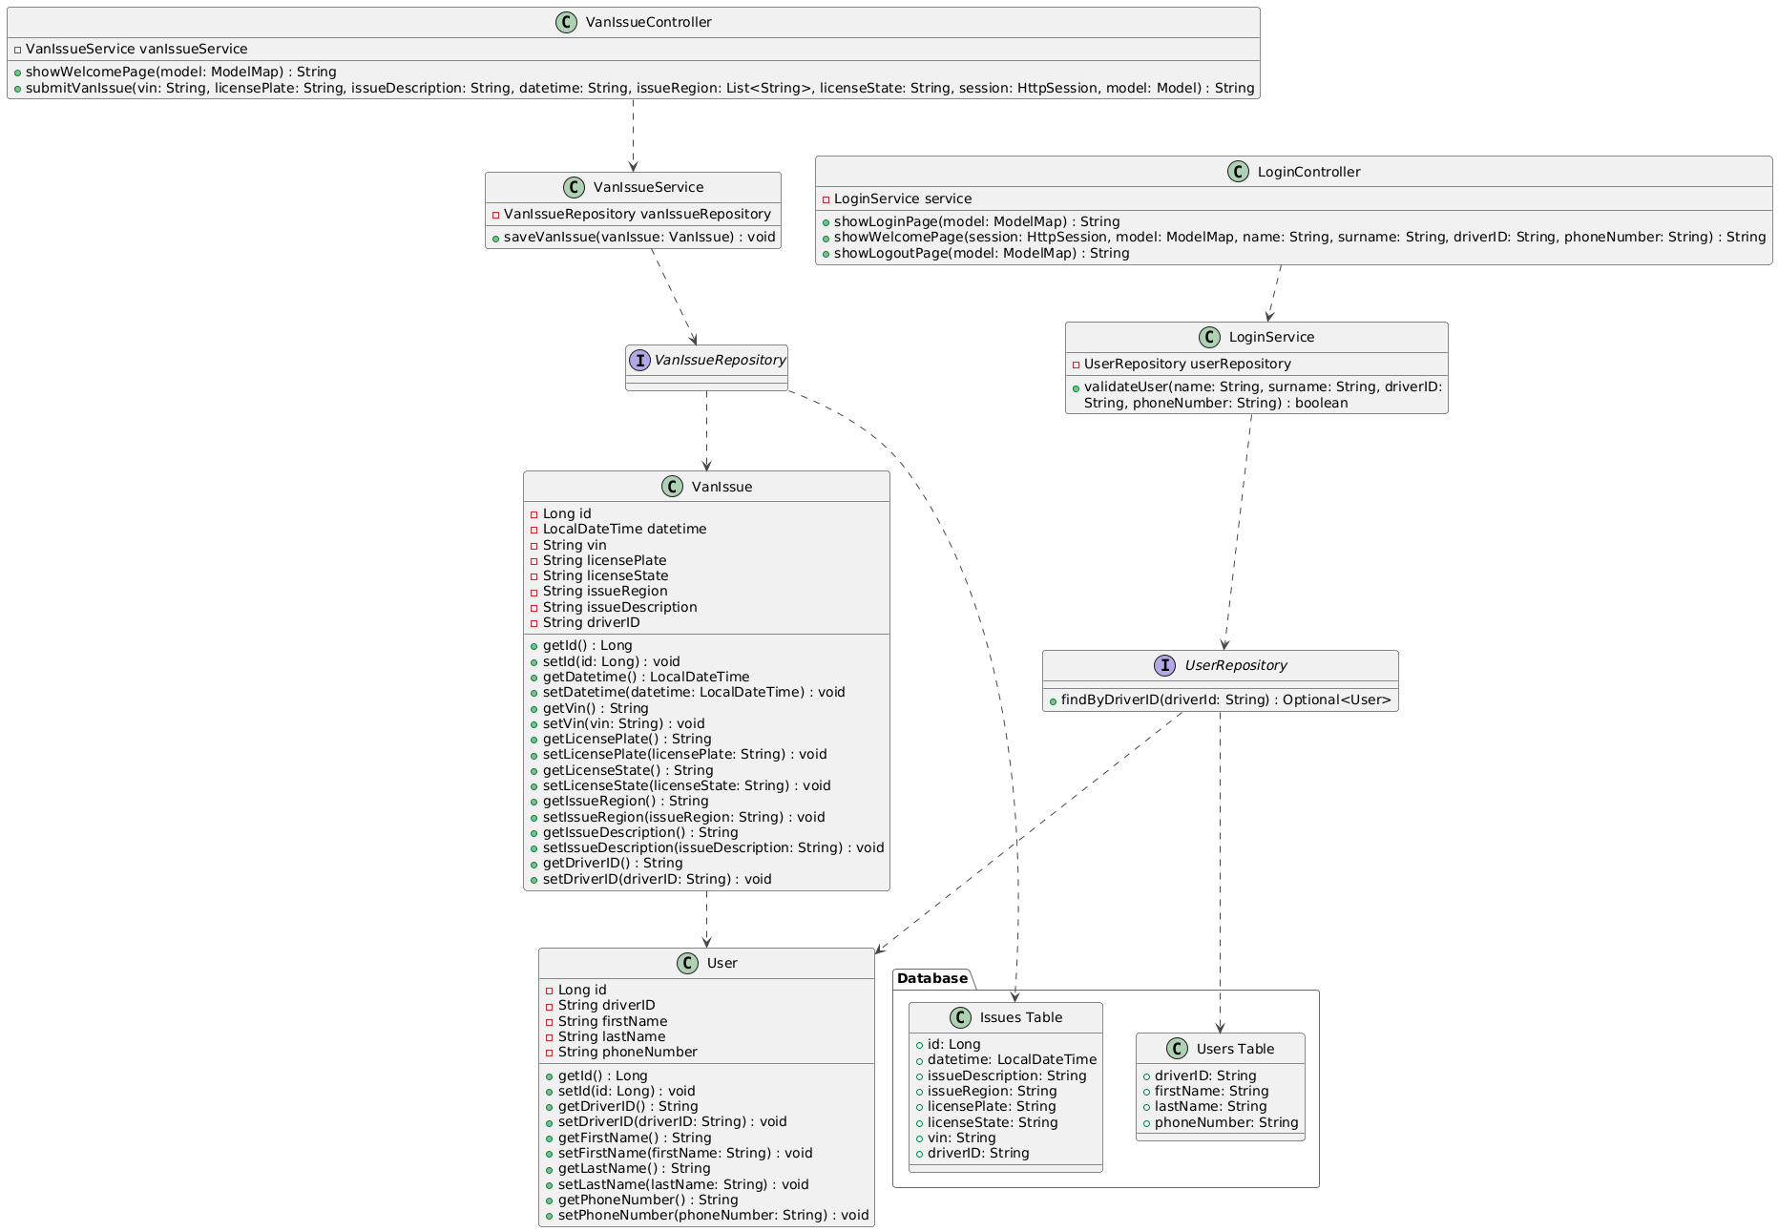
Database UML Diagram

Slide 12
Database Implementation

Slide 13
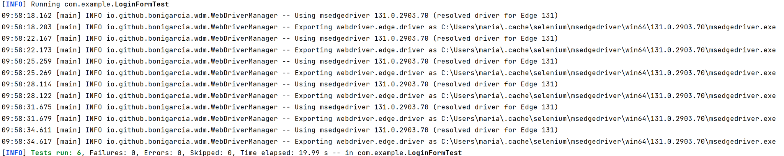
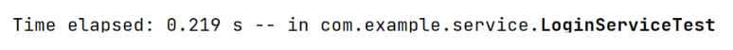
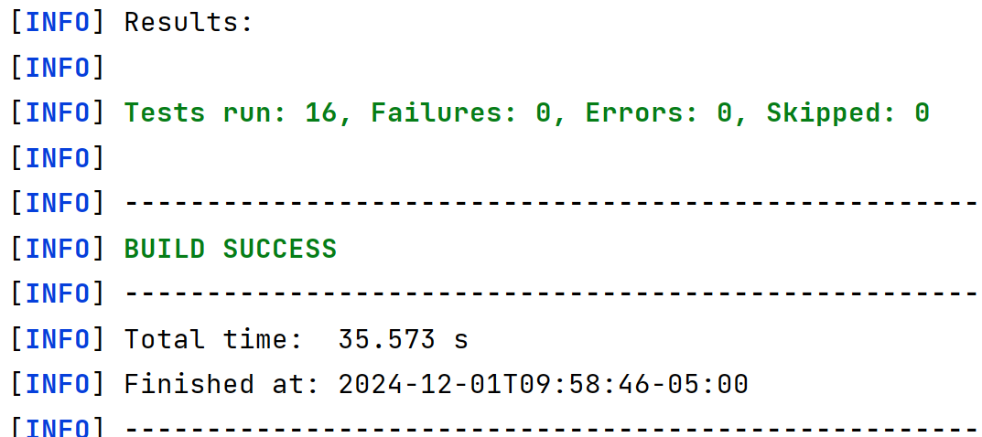
R.3 Testing of User Login Validation (First Page)
As a testing developer, I want to test the user authorization form for different user inputs so I can be sure that only amazon delivery drivers can log in.
Selenium Integration Testing of the first Page
Unit testing of validateUser service function
User cannot type any invalid keys to the form. (R.3.3-R.3.6)
User cannot access be redirected to the next page if credentials are not in the database, even is basic validation performed well. (R.3.1-R.3.2)
When we perform validation of user credentials, the credentials are not case-sensitive. (R.3.7)
If something does not match what we have in the database (actually mocking here), the function returns false.
1.
public void testInvalidName()
public void testInvalidSurname()
public void testInvalidDriverID()
public void testInvalidPhoneNumber()
2.
public void testCorrectCredentials()
public void testIncorrectCredentials()
void testValidateUser_caseInsensitivity()
void testValidateUser_incorrectDriverID()
void testValidateUser_incorrectPhoneNumber()
void testValidateUser_incorrectLastName()
void testValidateUser_correctData()
R.3.1: When valid credentials are entered, the user shall be redirected to the next (van issue documenting) page.
R.3.2: An error message shall be displayed indicating that the credentials do not match the pre-loaded database when incorrect credentials are entered (e.g., incorrect driver ID or other invalid fields).

Slide 14
Conclusion
What it accomplishes for the company
Adds new loop of communication regarding fleet
Cost Benefits
Allows contracted company to increase efficiency with vehicle repairs
What other features could be added in the future
Pictures
Create new driver credentials
Manager can access information
How this class went overall
Guest lectures were an insightful look into how different perspectives in same frameworks

